Slide 1
Requirements gathering, Analysis and WBS Disaster Response System
Group members
Nischal Neupane(4548125)
Sujan Khatri(4548147)
Ankit Roka(4530263)
Samrat pandey(4544194)

Slide 2
INTRODUCTION
This presentation discusses the Disaster Response System aimed at improving coordination and real-time assistance during disasters. That could range from natural disasters that could affect millions to small communities.
A Disaster Response System could effectively help reduce damage and save lives and a community-based approach could help local response capabilities.
We are using JIRA, WBS, and Draw.io for tracking, task breakdown, and visualization simultaneously for the development.

Slide 3
AGENDA
Requirement gathering
Definition and importance
Analysis
Importance
WBS
Definition
Case study and benefit
Case study 1 and 2
Stakeholders
Methods and techniques
Categorization
Prioritization
Tools and Methodologies for Requirements Analysis
Role of WBS
Best practice

Slide 4
REQUIREMENT GATHERING
In layman’s terms, requirement gathering is a process of gathering all the information before starting any big project where everyone is involved, finding out what functionalities they need, and updating the list as a project begins to take shape. For a Disaster Response System, it would be an early notification system, real-time reporting, and so on.
IMPORTANCE
It is very vital to do requirement gathering as it makes certain that all user requirements—such as prompt notifications, real-time reporting, and communication—are met.
STAKEHOLDERS INVOLVED
The stakeholders involved are primarily consumers, authorized personality/ community members, and the project team
METHOD AND TECHNIQUIES
Survey in-person
Brainstorming and workshop session
Analyzing the past data

Slide 5
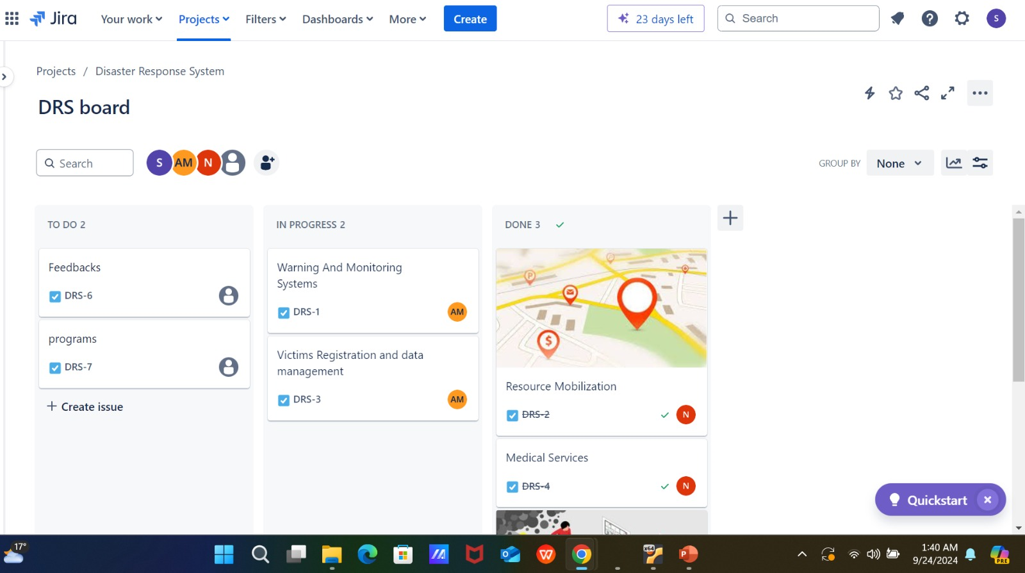

Slide 6
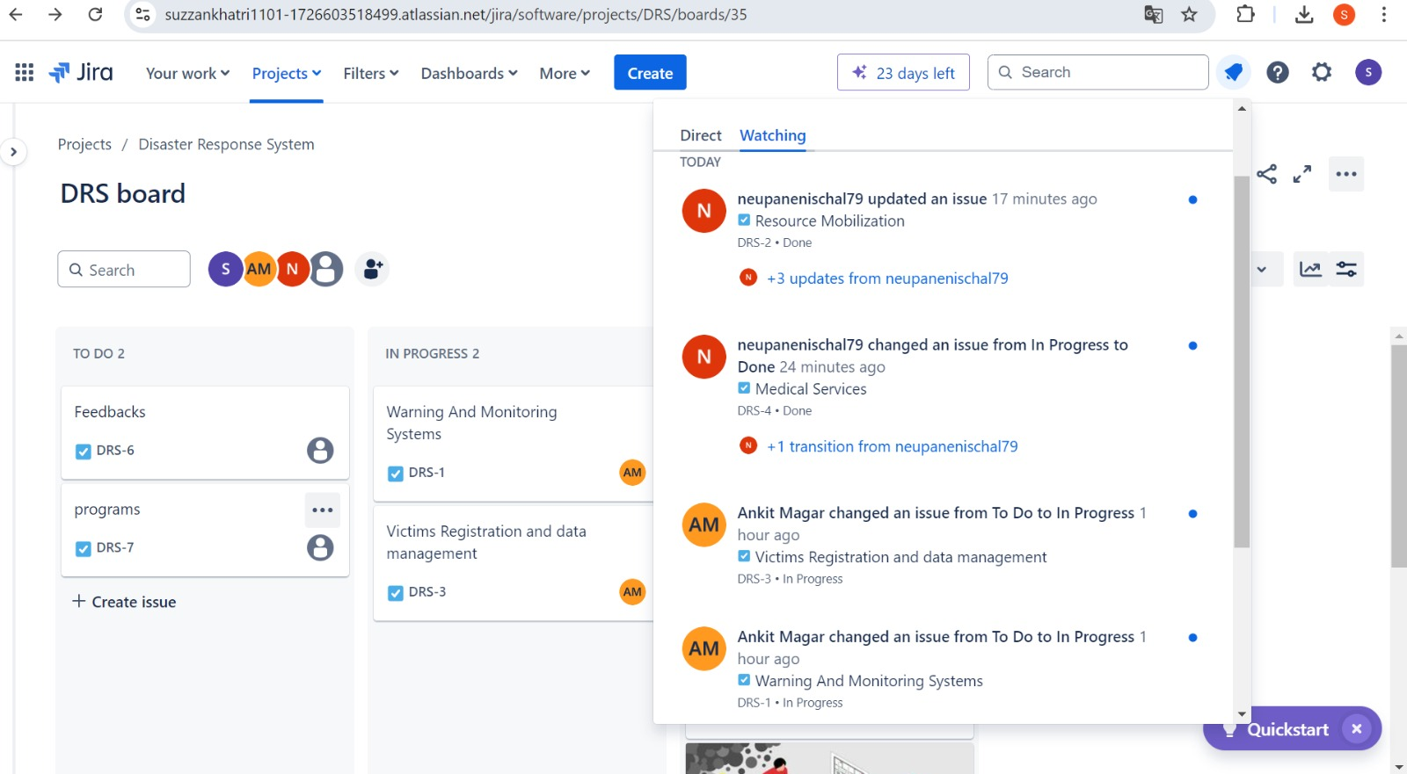

Slide 7
ANALYSIS
IMPORTANCE OF ANALYSIS
To ensure that the project is completed efficiently it is required to that analysis done in order to correctly prioritize. As analysis plays a critical role in transforming broad and vague requirements into smaller actionable plans.
CATEGORIZATION
we can group the requirements based on their nature such as functional requirements and non-functional requirements.
Functional requirements are real-time disaster alerts, geo-tagging
Non-functional requirements are geo-tagging, User Interface, system speed, etc.

Slide 8
PRIORITIZATION
Requirements are organized and prioritized based on their urgency and significance. Features of lower priority may be considered optional or introduced later, like post-disaster recovery tools, while high-priority features are essential for the system's operation, such as real-time alerts.
Tools and Methodologies for Requirements Analysis
To make the analysis comprehensive and precise various tools and methodologies are used.
Requirement Traceability Matrix RTM This would also help in mapping each requirement back to its source-that is, stakeholder-and link it to its corresponding deliverable. It makes sure that no requirements are missed out and allows the tracking of changes throughout a project's life. Example: Requirement: Real-time disaster notifications. Source: Community survey; local authorities. Linked Deliverable: Mobile app notification system.

Slide 9
SWOT Analysis: Strengths, Weaknesses, Opportunities, Threats SWOT analysis evaluates the relative strengths and weaknesses of the proposed system and external opportunities and risks likely to affect project success. Example: Strength: Real-time alerts allow for quicker responses. Weakness: Possible difficulty in reaching remote areas. Opportunity: Exploiting existing infrastructure, such as cellular networks. Risk: Poor connectivity in some regions.

Slide 10
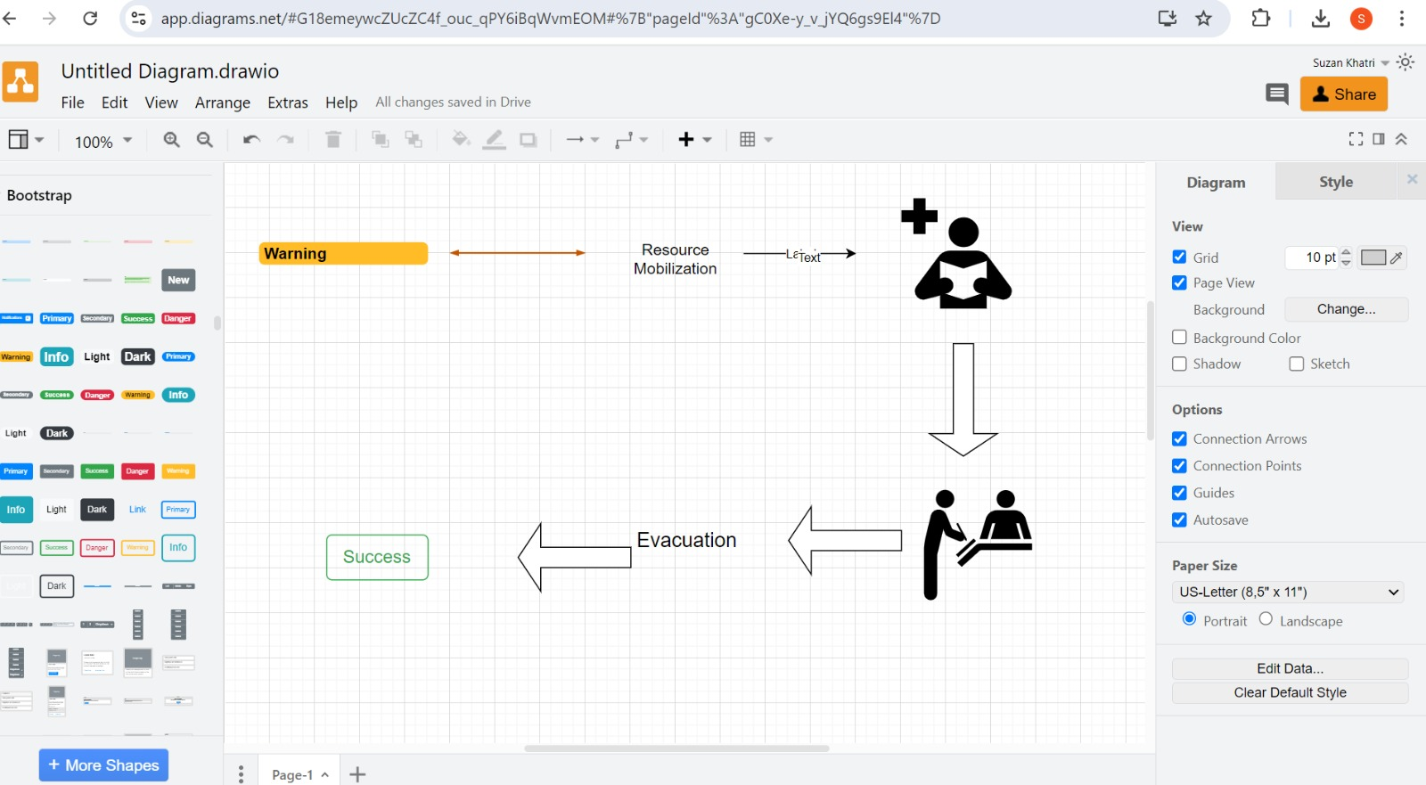

Slide 11
WBS
Work Breakdown Structure also known as WBS is a project management tool that helps break down a project into smaller, more manageable components. It helps to visualize and organize projects into different levels based on dependencies, to make it easier to plan, execute and monitor.
Role of WBS in project planning
The WBS clarifies what needs to be done, by whom, and when. It helps the project team assign responsibilities, schedule tasks, and estimate the resources required. In the case of Disaster Response system
Improved project planning and scheduling by:
It allows defining and structuring on tasks clearly with WBS; hence, it's easy to estimate time, costs, and resources that will be needed for each component of the project.

Slide 12
Improved communication and clarity:
WBS visualizes project breakdown, ensuring that all parties concerned in the project view the deliverables and responsibilities. Therefore, this limits misunderstandings.
Efficient resource allocation:
It helps them to concentrate resources precisely where they are required and avoid wastage by making use of the team members, time, and budget.
Smarter risk management:
Clear identification of individual tasks and their inter-relationships enables early identification of possible risks and bottlenecks, hence enhancing proactive risk mitigation strategies.

Slide 13
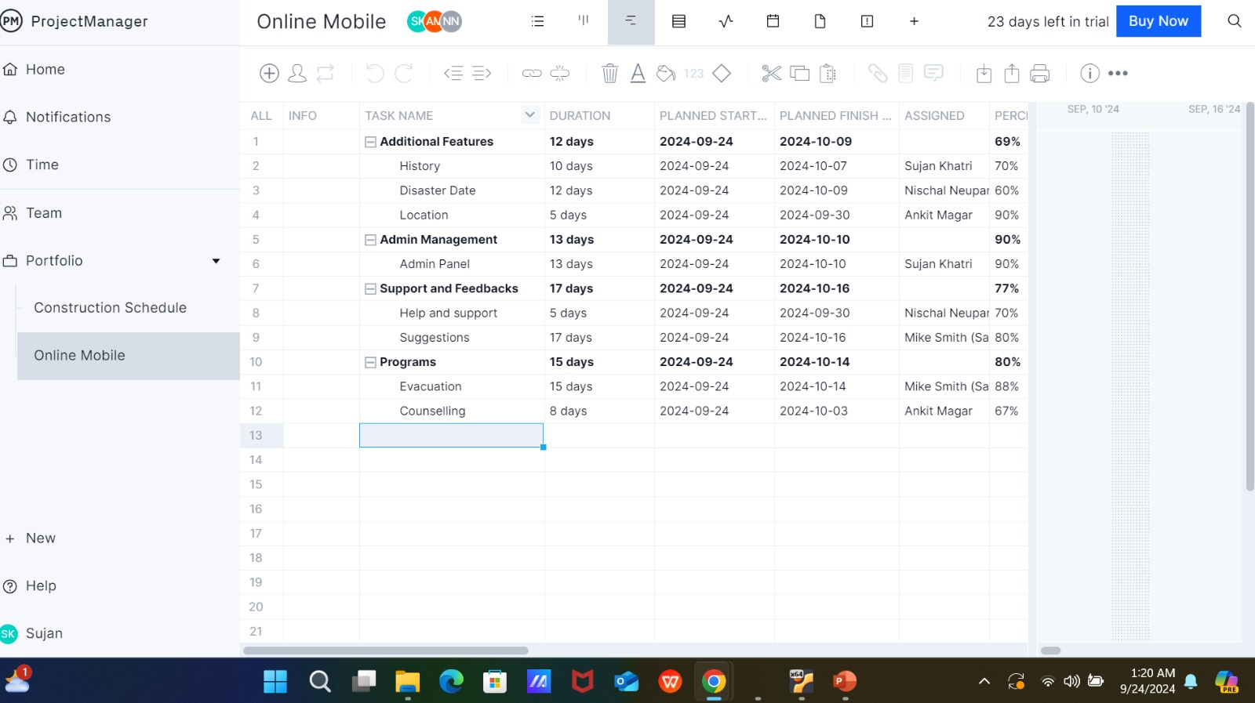

Slide 14
Timeline and milestone
Week 1: Complete the Registration and Authentication System
Tasks: user registration, login, authenticating user, and database creation.
Estimated Cost: $2,000
Cloud-based database setup $1,200
Security and Encryption Services: $ 800
Week 2: Emergency Reporting Module Closed
Features: disaster reporting features, including geolocation services.
Estimated Cost: $1,500
Geolocation API Service Subscription: $ 1,000
Reporting interface development - software, tool licenses: $500
Week 3: Design Real Time Alert System
Tasks: Notification system: SMS, email, in-app; integration with local services.
Estimated Cost: $3,000
SMS and email service providers setup: 1,500
Set up a notification system-push services, software licenses: 1,500
Week 4: Resource Allocation & Inventory Management Module
Activities: Establishing inventory for emergency items, like food and medical supplies.

Slide 15
Estimated Cost: $2,500 Inventory management software: 2,000 Cloud inventory data storage: $500 Week 5: Volunteer Organization & Assignment Among others, are the volunteer sign-up system, task assignments, and follow-up. Estimated Cost: $1,800 Volunteer management tools: $1,300 - SaaS or third-party service Extra integration tools: $500 Week 6: Evacuation Route Mapping System Exercises: Real-time mapping of escape routes with the help of local infrastructure information. Estimated Cost: $3,500 Mapping API service: $2,000 (e.g., Google Maps API) Geographic Information Systems tools 1,500 Week 7: Medical Aid & First-aid Solicitation System Tasks: The system allows users to request medical help and connect them with hospitals. Estimated Cost: $3,000 Third-party API integration of medical services, licensing fees: $2,000 Emergency response coordination tools: $1,000 Week 8: System Testing and Debugging Exercises: Test core functionality, stress test, and debug. Estimated cost: $2,500 Testing tools and software, including automated test platforms: 1,500 Bug Tracking Software: $1,000 Week 9: Integration with external disaster management systems Activities: Liaising with national disaster responses and NGOs. Estimated cost: $2,500 API Integrations for Disaster Response Data $1,500 Establishing communication protocols: $1,000 for real-time data exchange. UAT - User Acceptance Testing,
Week 10 Activities: Conduct UAT with local communities and emergency responders. Estimated Value: $2,500 UAT tooling: feedback collection tool, user interface testing tool, etc.: 1,500 Final polish upon feedback: $1,000 Miscellaneous/Contingency Fund Estimated Cost: $4,200 Additional software tools, licenses, or unforeseen project costs.

Slide 16
Case studies
Case Study 1: Hurricane Response in Florida, 2018
Problem:
What was needed immediately after the storm was a fast network for sending messages for evacuation alerts and the coordination of relief.
WBS Application:
Top-level goal: Developing a disaster response real-time system.
Major Deliverables:
Evacuation Warning System: Create a warning system to alert citizens.
Community Coordination Module: This provides coordination between emergency responders and the local community.
Resource Tracker: Monitor and give out resources-food, water, medical supplies, etc.
Activities and Work Packages
Mobile Application Development: Design and subsequently test a mobile application that issues real-time warnings.

Slide 17
Set up the notification system by implementing SMS, push, and geo-based notifications.
Communication Channels: Thus, laying a line of communication between the emergency responders and the stricken communities.
Logistics of Supply Distribution: Plan and follow up on feeding and consumables distribution.
Outcome:
WBS helped in the organization of these activities into manageable components, taking over roles among the team members, and monitoring progress. This will ensure that the evacuation and relief operations are efficiently done without losses that may be caused by delays.

Slide 18
Case Study 2 Earthquake Response in Nepal 2015 Challenge: This disastrous earthquake in Nepal highlighted important coordination issues concerning relief, proper management of resources, and also ways to reach the most inaccessible areas with aid and assistance. WBS Application: Top-level goal: the system design of earthquake disaster response and relief. Major Deliverables: Damage Assessment System: Establish a system of surveying and prioritizing according t the extent of damage. Distribution of Relief Supplies: Design the system for the distribution of supplies like food, water, and medical aid. Communication and Coordinating Platform: Direct communication among rescue teams, local authorities, and international aid organizations should be established. Activities and Work Packages

Slide 19
Damage Assessment using Geo-tagging: Mapping of the affected areas, using drones and satellite imagery. Design an interactive platform for showing where emergency intervention is required.
Relief Distribution: Put in place mechanisms to monitor the distribution of relief supplies. Give top priority to resource distribution in the most impacted region.
Communication Network Setup: Establish a wireless communication network for first responders and volunteers. Allow real-time coordination and collaboration with international aid agencies in deploying resources. Local Community Support: Training community volunteers to support in relief work. Establish information dissemination platforms for public safety instructions. Example Explanation: Earthquake Disaster Response System. Level 2: Damage assessment, distribution of relief and communication setup

Slide 20
. Level 3: Specific missions, such as disaster area mapping, may be performed in concert with local responders by establishing supply chain systems. Outcome: WBS was put into application for structuring the earthquake response system of Nepal and making it more manageable, considering such a huge disaster magnitude. Additionally, relief efforts were decomposed into smaller task-level activities through which worst areas were prioritized and accordingly aid deployment forwarded where most required, and communications between local to international

Slide 21
Best practice
Best Practices for Requirements Gathering: -Validate Requirements Early
-Engage All Important Stakeholders -Employ different methodologies
Best Practices in Analysis: -Categorize and prioritize requirements -Visual tools include -Conduct Feasibility Analysis Best Practices of WBS: -Break the project down hierarchically: -Start with high-level deliverables, breaking them down into granular tasks. -Ensuring Manageable Work Packages:

Slide 22
Things to avoid
Common Pitfalls:
Incomplete Requirements Gathering:
Issue: Failing to involve all stakeholders can lead to missing critical requirements.
Strategy of Avoidance: Engage broadly with stakeholders, capturing views using a range of methods.
Lack of clarity about the requirements.
Problem: Ill-defined or vague requirements are misunderstood, leading to scope blowout.
Avoidance Strategy: By using explicit terminologies, diagrams, and verification of the need from the stakeholders.
Overly Complicated Analysis
Problem: If the team is analyzing too many variables at one time, it may overwhelm them and obscure key insights.
Avoidance Strategy: Simplify the process of analysis by categorizing and prioritizing the requirements.
WBS not well-defined:
Problem: A poorly developed WBS can result in misunderstandings of responsibilities and project scope.
Avoidance Strategy: A well-structured WBS, well-settled hierarchies, and manageable work packages. Dependencies overlooked:
Problem: Incomplete task dependencies may show an inaccurate project timeline.

Slide 23
Conclusion
This system, in essence, is a very major tool that will enhance real-time disaster management, resource allocation, and communication within the local community and with the emergency responders. It will efficiently handle various disaster scenarios, timely responses, and coordination with volunteers and medical services through effective capturing of the requirements, analyzing the needs of the system, and implementation of a clear Work Breakdown Structure. A well-planned budget complemented by an organized timeline would, therefore, go a long way in reducing disaster impacts on communities in saving lives and resources.

Slide 24
THANK YOU

Slide 25
Refrences
“Nepal Earthquake Response 2015: Lessons Learned in Disaster Management and Technology”
Harvard Business Review – Project Management Articles:“Why Good Projects Fail Anyway” (Offers insights into the role of requirements and WBS in avoiding project failure.) www.hbr.org
Larson, E., & Gray, C. (2017). Project Management: The Managerial Process. McGraw-Hill Education.Offers insights into project management processes, including requirement analysis and task breakdown.

Slide 26
Contact
Nischal Neupane
neupanenischal79@gmail.com
Sujan Khatri
suzzankhatri1101@gmail.com
Ankit Roka
ankitroka2003@gmail.com
Samrat pandey
pandeysamrat779@gmail.com

